Slide 1
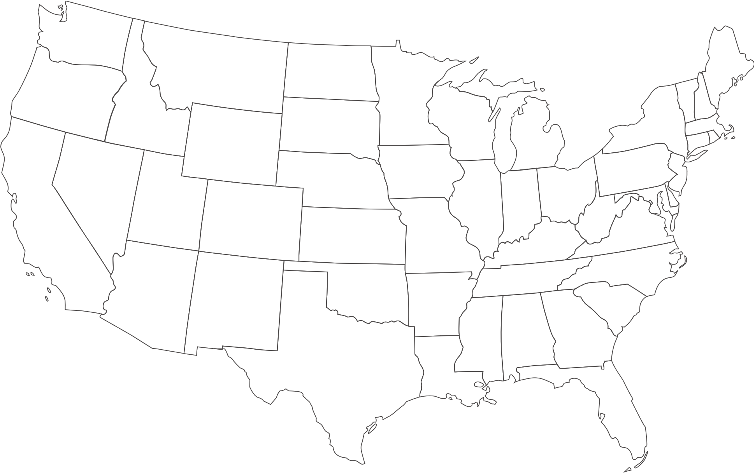



Agency Administrator Overview
September 2022

Slide 2
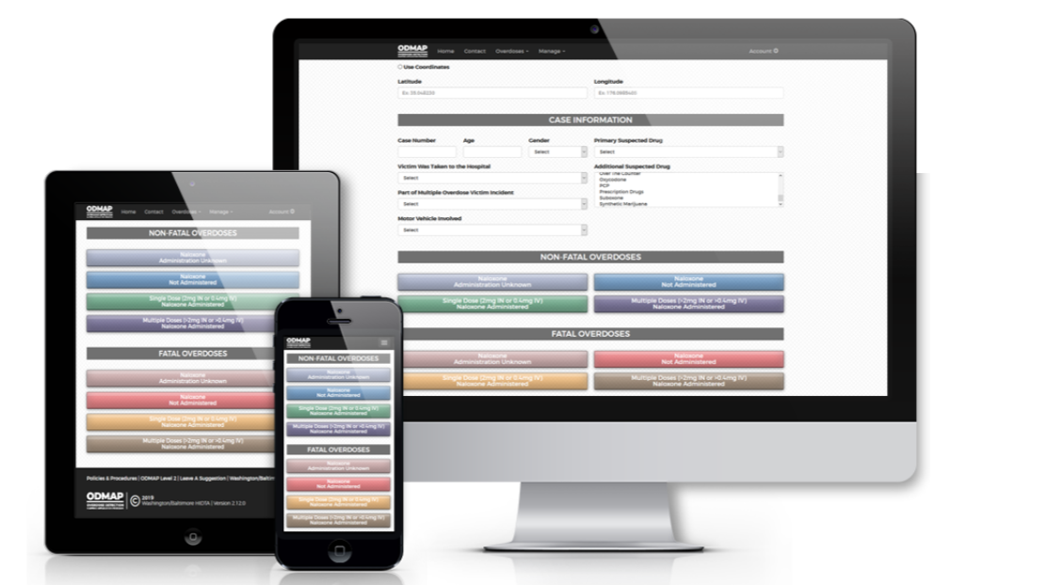


What is ODMAP?
ODMAP is a free, web-based tool that provides near real-time suspected overdose data to support public safety and public health efforts to mobilize an immediate response to overdose events

Slide 3
ODMAP Program Goals
Providing near real-time suspected overdose data
Providing participating agencies with data to identify suspected overdose occurrences and spikes in near real-time
Enabling participating agencies to develop effective strategies for addressing overdose incidents occurring in their jurisdictions
Enhancing the development of regional strategies designed to prevent the spread of substance use disorders resulting in overdose incidents

Slide 4
ODMAP Agency Eligibility
  Federal, State, Local, and Tribal
    Law enforcement/criminal justice personnel (including medical examiners/coroners)
    Public Health Personnel
  Licensed first responders (Fire/EMS)
  Hospitals with emergency departments
  All agencies must sign a Participation Agreement prior to gaining access, it outlines the ODMAP Policies and Procedures

Slide 5
ODMAP Access
Signing up for ODMAP
Adding New Users

Slide 6
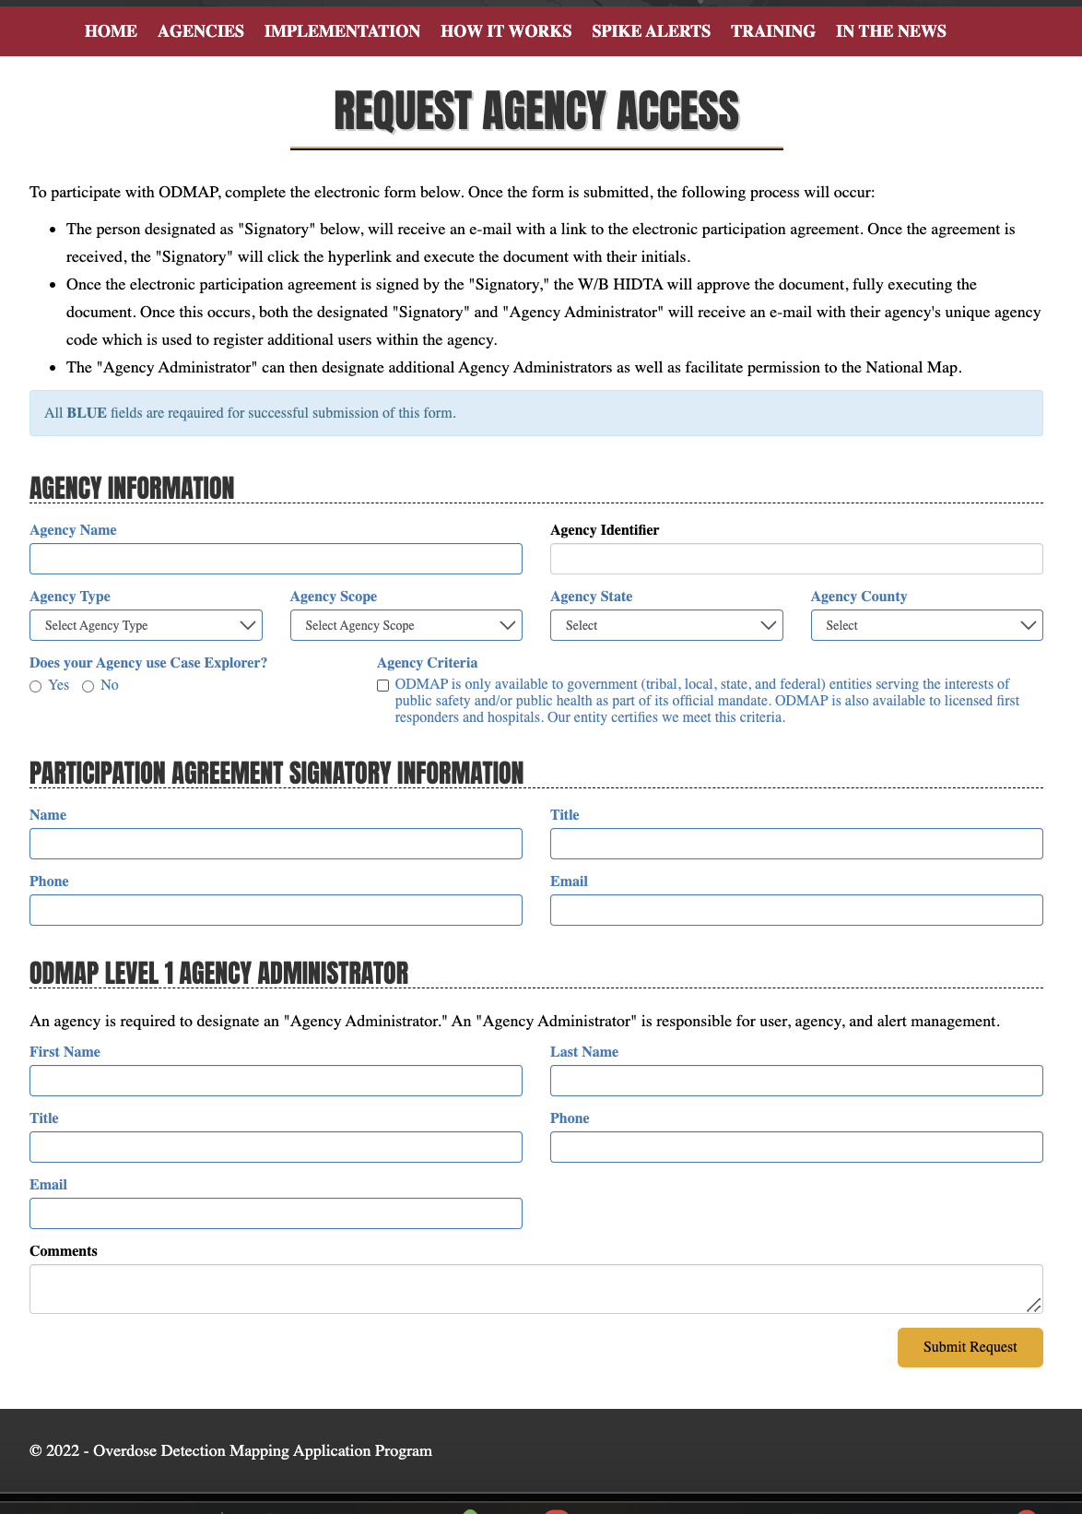
Requesting Agency Access
  To register, go to ODMAP.org and click on the “Request Agency Access” button
  Agencies are required to complete all fields that are in blue

Slide 7
Requesting Agency Access
  The form will ask for contact information for both the Signatory and the Agency Administrator
  Once the form has been submitted, the ODMAP team will review the application and send over the Participation Agreement

Slide 8
Requesting Agency Access
  Once the form has been submitted, the following will happen:
    The person designated as "Signatory" will receive an e-mail with a link to the electronic participation agreement, then click on the link and then initial the document
    Once the electronic participation agreement is signed by the "Signatory," then the ODMAP team will approve the agreement.

Slide 9
Requesting Agency Access
  Once the form has been submitted, the following will happen (cont.):
    As a result, both the designated "Signatory" and "Agency Administrator" will receive an e-mail with their agency's unique agency code which is used to register additional users within the agency
    The "Agency Administrator" can then designate additional administrators, onboard new users, designate permissions, and create alerts
    For more information, watch our YouTube tutorial on requesting agency access

Slide 10
Registering a New User
Once your agency has completed all steps and your Agency Administrator has received the agency code, you will be able to add additional users
New users from your agency will go to: odmap.hidta.org/Account/Register and fill out the form using the unique agency code.
You cannot register as a new user until your agency has been approved
For more information, watch our YouTube tutorial on adding new users

Slide 11
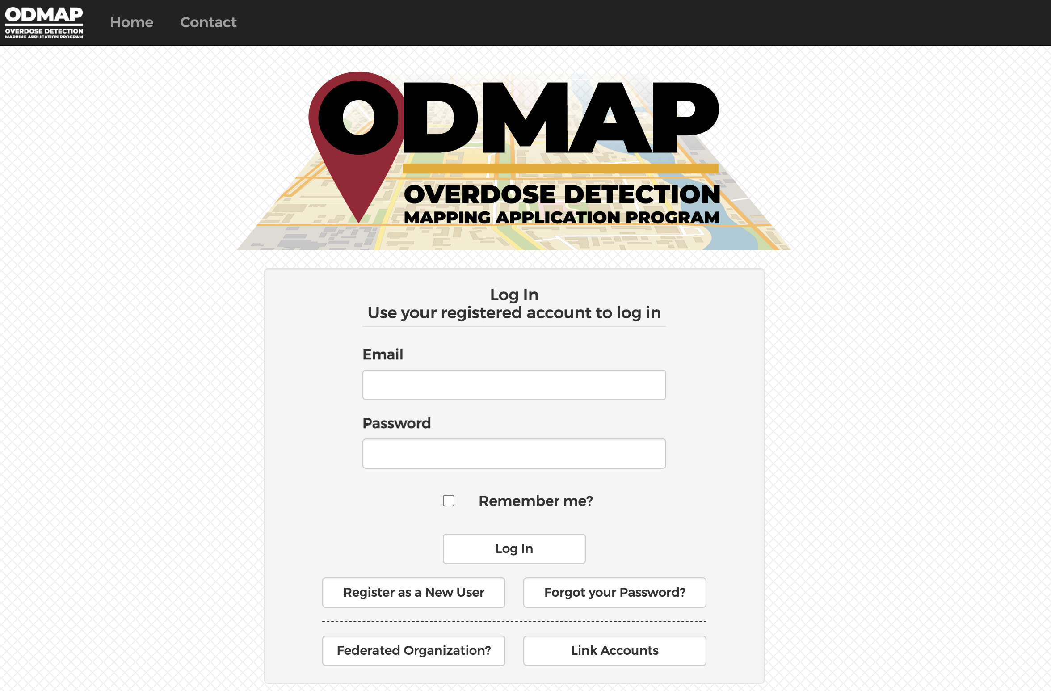
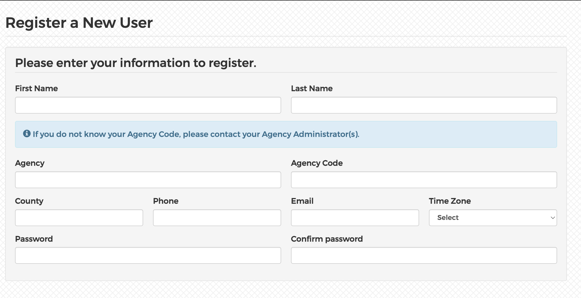
Registering a New User
Click here and then use your agency code to sign up as a new user

Slide 12
ODMAP User Tools

Slide 13
Logging In
Go to odmap.hidta.org
Once you are an approved user, login using your email and password
You will need to reset your password at your account is approved
If you do not login at least once within a six-month period, your account is frozen and will need to be reset

Slide 14
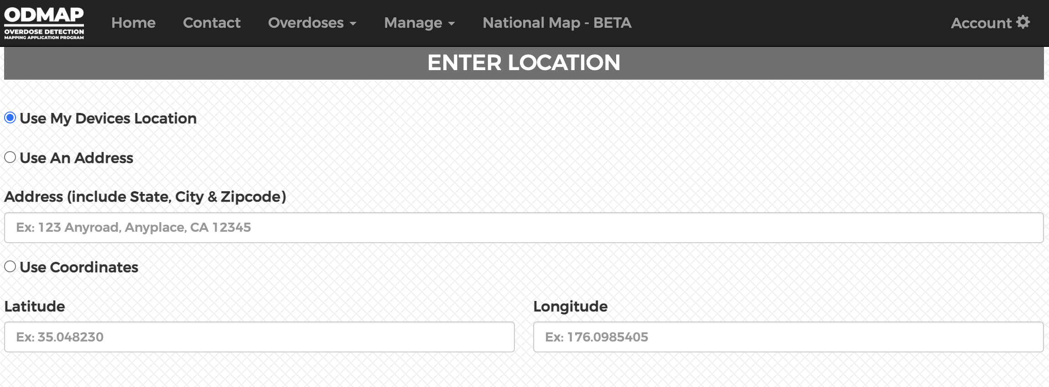
Toolbar

Slide 15
Toolbar
Click here to manage your overdose and query your agency’s data
If you are an admin, the manage button is where you manage alerts and users
Click here to go to the National Map

Slide 16
ODMAP Data Entry and Tools

Slide 17
ODMAP and HIPAA
ODMAP is not considered a “system of record” – it collects location, date/time, fatality status, and naloxone administration
        The information captured by ODMAP is not considered PHI - the location is translated into a geo-located point where an overdose occurred without any other information about a person
        W/B HIDTA and ODMAP do not retain any address information within the platform or on the server (they are deleted)
        ODMAP Zoom function is restricted to a zoom Level ID: 15 (scale of 1:18055.95)

Slide 18
Overdose Event Data Points Collected by ODMAP
Each case entry must include:
  Date and Time
  Location
  Outcome (fatal/non-fatal)
  Naloxone Administration
Agencies can add additional information, including:
  Suspected drug
  Demographics (age and gender)
  Transported to hospital

Slide 19
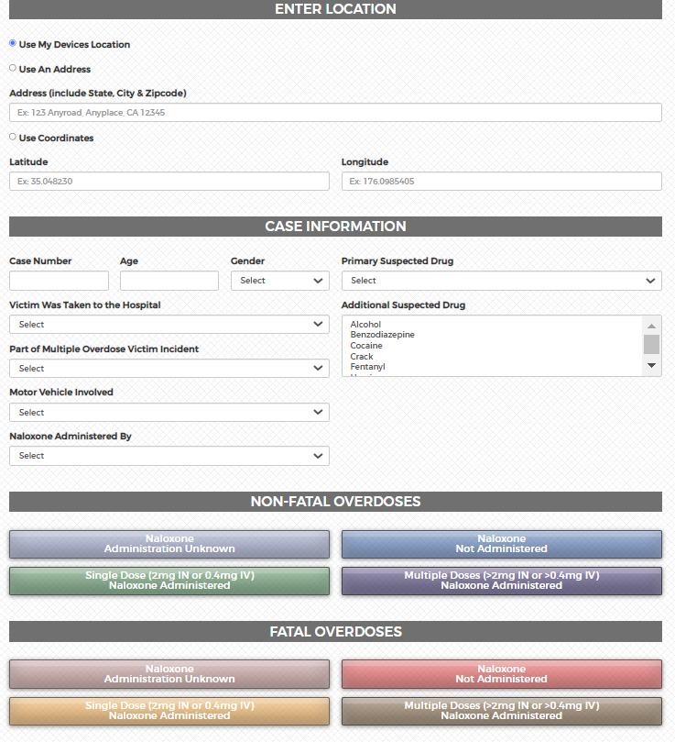
Overdose Event Data Entry Methods
Suspected overdose cases can be entered into the ODMAP system in three ways:
  Manual entry through the secure website (ODMAP is mobile friendly)
  ODFORM (for Case Explorer agencies)
  Application Programming Interface (API)

Slide 20
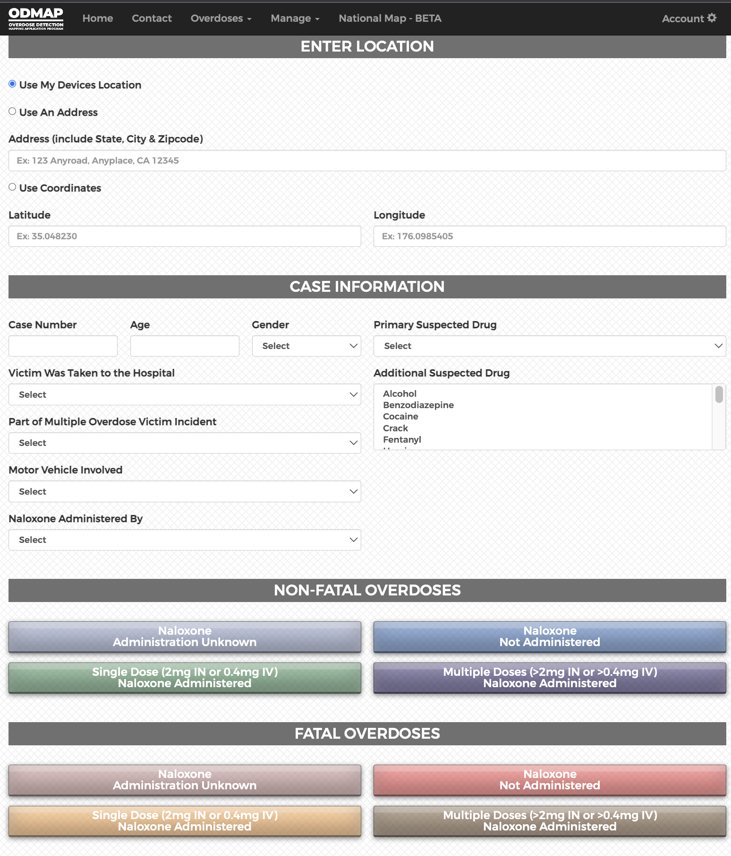
Overdose Event Data Points Collected by ODMAP
Start by entering the location of the overdose
You can use your device's location, type in an address, or enter lat/long
Address are geocoded and then deleted from our system
This box turns green when the address is successfully geocoded

Slide 21
Overdose Event Data Points Collected by ODMAP
In the Case Information section, you can enter additional details
  Suspected Drug
  Age
  Gender
  Multiple Victim
These are all optional fields

Slide 22
Overdose Event Data Points Collected by ODMAP
Naloxone and outcome are bucketed into eight categories
Once you click, it will take you to the next page

Slide 23
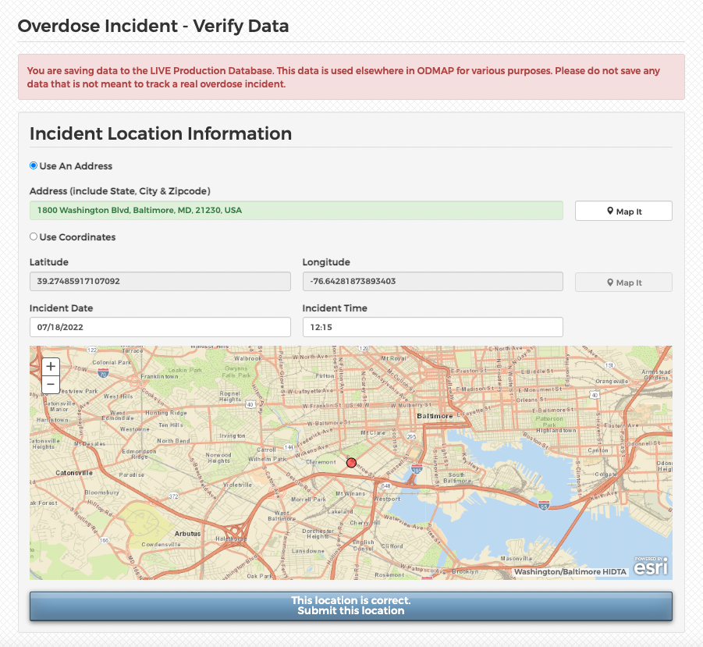
Overdose Event Data Points Collected by ODMAP
Enter the date and time of the incident
Then, confirm the location is mapped correctly
Hit submit and it will plot onto ODMAP

Slide 24
ODMAP Tools
The National Map and Spike Alerts

Slide 25
ODMAP Features
ODMAP National Map
  Cross jurisdiction suspected overdose information
  Filters
  Heat maps
  Charts
Spike, Overdose, and Statewide Alerts
Adding personal data and Esri web layers
Multiple agencies providing data for areas, capturing more suspected events

Slide 26
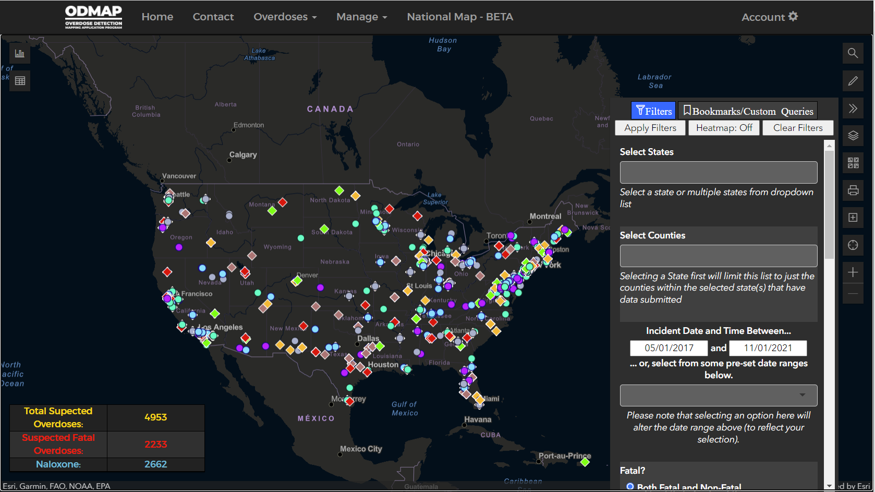
National Map and It’s Features
On the National Map:
Circles are non-fatal overdoses
Diamonds are fatal overdoses
Color-coded by naloxone administration
For more on the National Map, see our YouTube tutorial

Slide 27
National Map and It’s Features

Slide 28
Default 24-hour Summary Statistics

Slide 29
Built-it filters to do deep dives into ODMAP data, including:
Dates
Location
Type of Drug

Slide 30
Built-in, downloadable charts, including:
Outcome and Naloxone Administration
By Day/Month
County/Line Comparison Chart

Slide 31
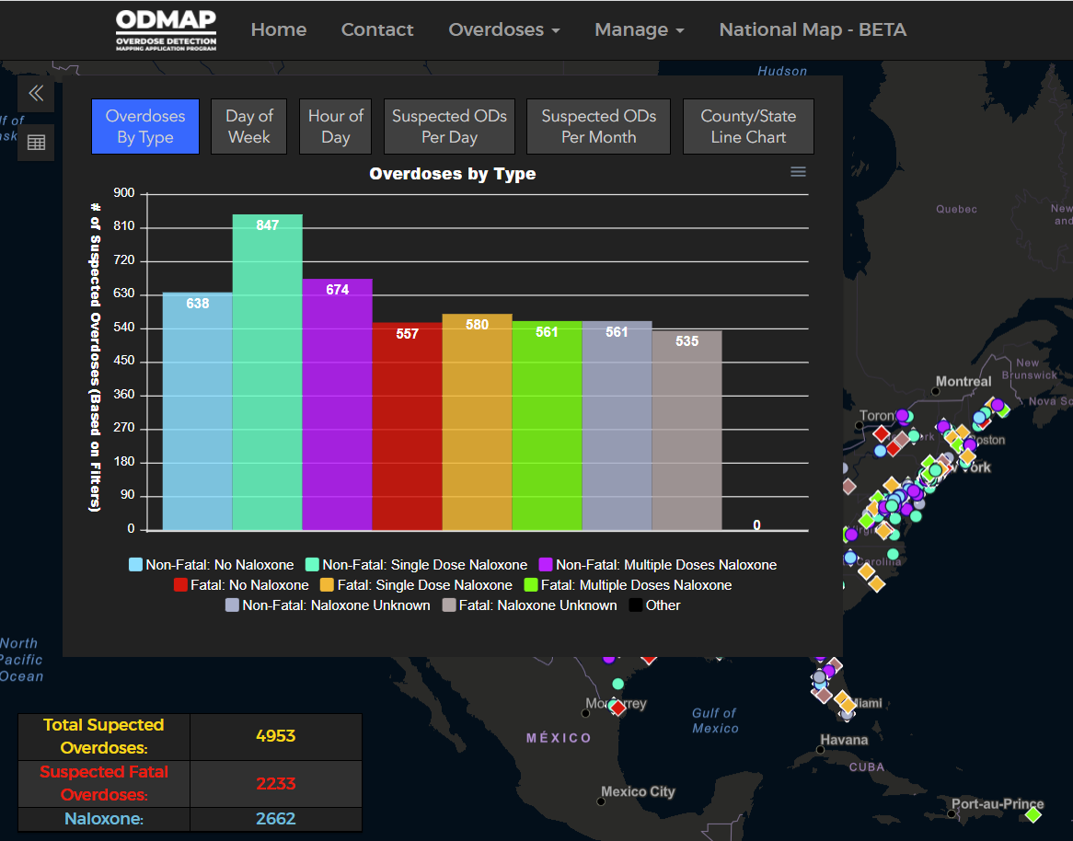

Slide 32
Spike Alerts

Slide 33
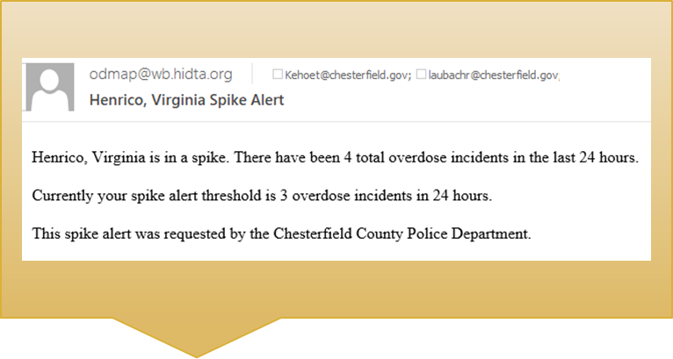
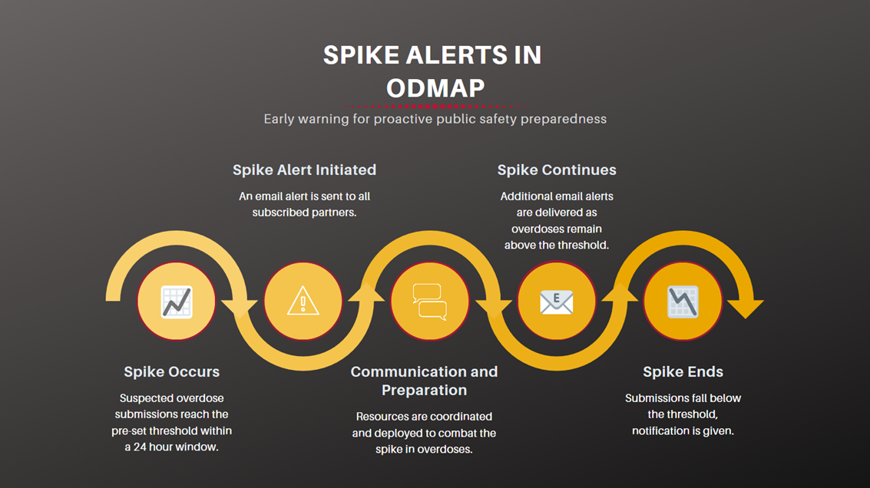
Spike Alerts

Slide 34
Spike Alerts
  ODMAP Spike Alerts are designed to alert users when an overdose spike occurs, in near real-time
  Spike Alerts occur at the county level, users can set up spike alerts for any county across the country
  It is intended to give the public safety and public health community real-time alerts to mobilize a response strategy
  Spike alerts can only be set up by Agency Administrators
  For more information on setting up Spike Alerts, see our YouTube Tutorial

Slide 35
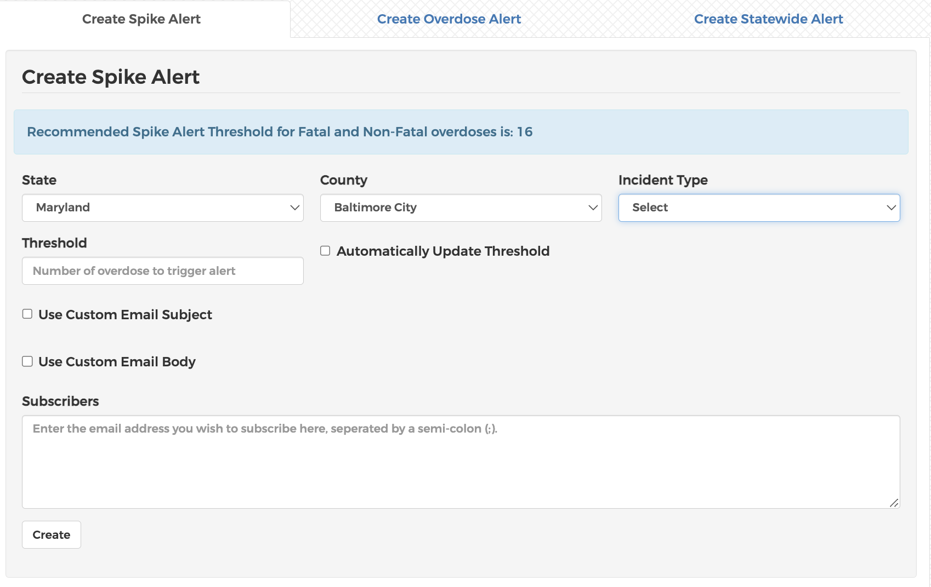
Setting up Spike Alerts
  When setting up a spike alert, you will need to determine the threshold
    ODMAP will recommend a threshold based on historical overdose patterns in the county, however, you can choose your own threshold

Slide 36
Setting up Spike Alerts
  You can customize spike alerts to include your own language in the email subject line and in the body of the email
  You can also send to multiple people using the subscriber list feature

Slide 37
Spike Alerts
  Once the selected county has met or exceeded the threshold within a rolling 24-hour period, an email notification will be sent out to everyone on the email list for the spike
  Another notification will be sent out once the number drops below the threshold, indicating an end to the spike
  If the county is in a spike for over 24-hours, an email will be sent saying the county remains in a spike

Slide 38
ODMAP in the Field
How do Agencies Use the Data in ODMAP to Drive Decisions

Slide 39
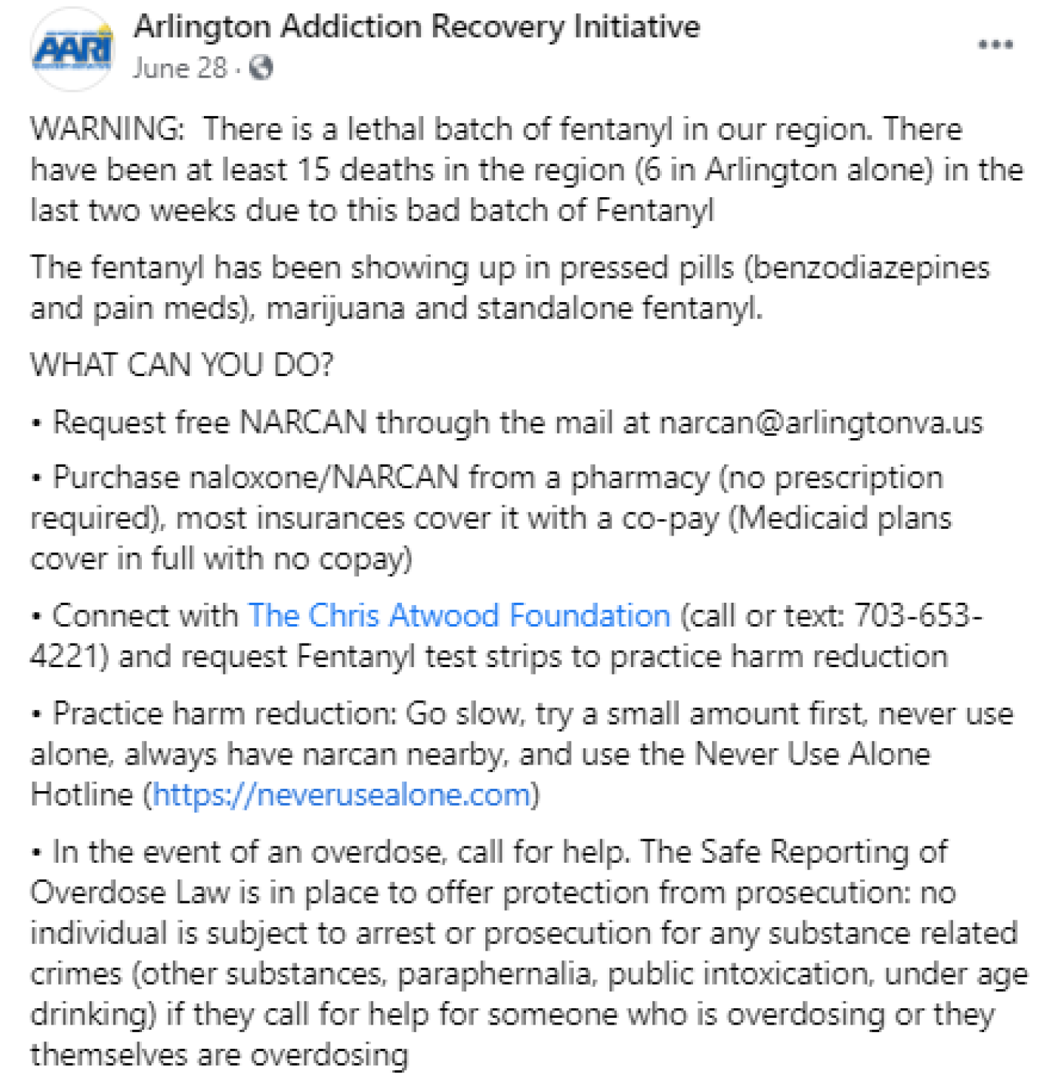
Spike Alerts in the Field: Arlington County, VA
On June 28, 2021, a spike alert was triggered for Arlington County, Virginia
Public safety and health officials reached out to neighboring counties to identify scope of the spike
Two other Northern Virginia counties reported higher than normal overdoses over the past weekend
Arlington County stakeholders drafted a community alert and posted information on their coalition Facebook page, it included:
  Information on the presence of Fentanyl
  ^{Local resources}
  Information on the local Safe Reporting of an Overdose Law

Slide 40
Spike Alert Response Teams/Protocols
Agencies create a tailored spike response program to ensure there is a quick response to increases or spikes in overdoses
Should include public health, law enforcement, EMS, hospitals, and adjacent agencies (i.e. medical examiners/coroners and hospitals)
Can set up spikes for any threshold on ODMAP, so agencies can be alerted based on their agency's prevention/response program

Slide 41

Outreach Teams
Agencies can use ODMAP to identify cases in their specified jurisdiction
Once an overdose is identified, they will connect with the reporting agency and implement their follow-up protocol
Specific case information comes from the agency itself, not ODMAP

Slide 42
How You Can Get Started with ODMAP
If you are part of an eligible agency, you can request agency access to ODMAP at odmap.org and complete the form
Once approved, you can login and begin using ODMAP and all its features, like the National Map
If you are part of an ODMAP agency, you can work with your admin to be added as a user using their agency code

Slide 43
Questions?
Please contact:
Ali Burrell, ODMAP Program Manager – aburrell@wb.hidta.org
Marquis Johnson, ODMAP Coordinator – mjohnson5@wb.hidta.org

